Slide 1

DJJJ Presents
SBMS
Smart Business Management System
Dawson, Brown
Judah, Csanyi
Joshua, Leslie
Jeremy, Paruch

Slide 2
Meet
The
Team

Slide 3


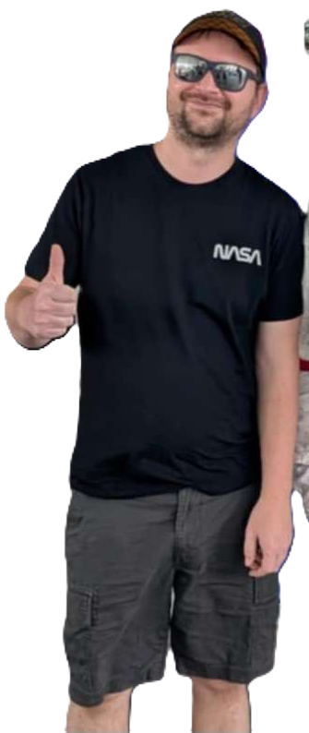

Meet
The
Team
Primary: Programmer
Primary: Programmer
Primary: Programmer
Primary: Organizer
Dawson Brown
Judah Csanyi
Joshua Leslie
Jeremy Paruch
Secondary: Speaker
Secondary: Bug Catcher
Secondary: Bug Catcher & UML
Secondary: Bug Catcher & Programmer

Slide 4









Main Menu

Slide 5




LogIn
User Login

Slide 6
1

Slide 7
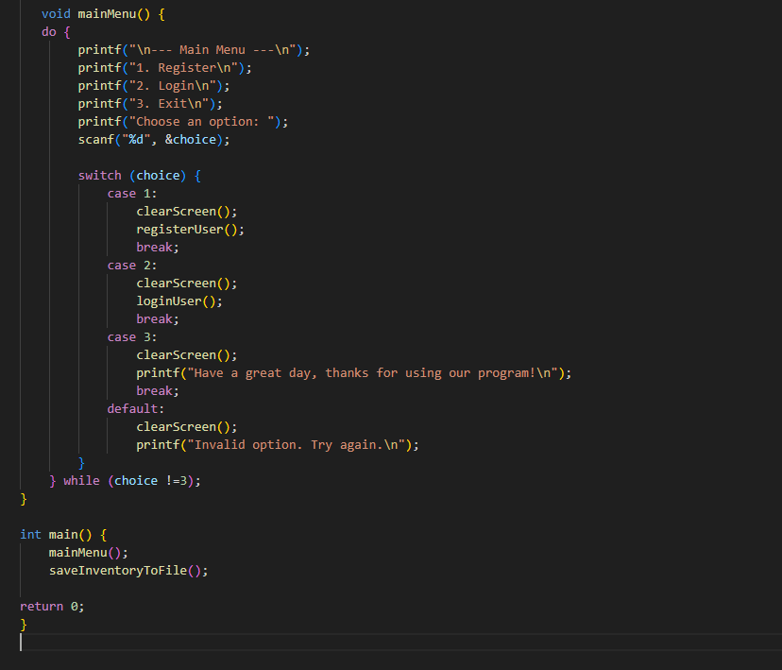
Main Menu
1

Slide 8
2

Slide 9
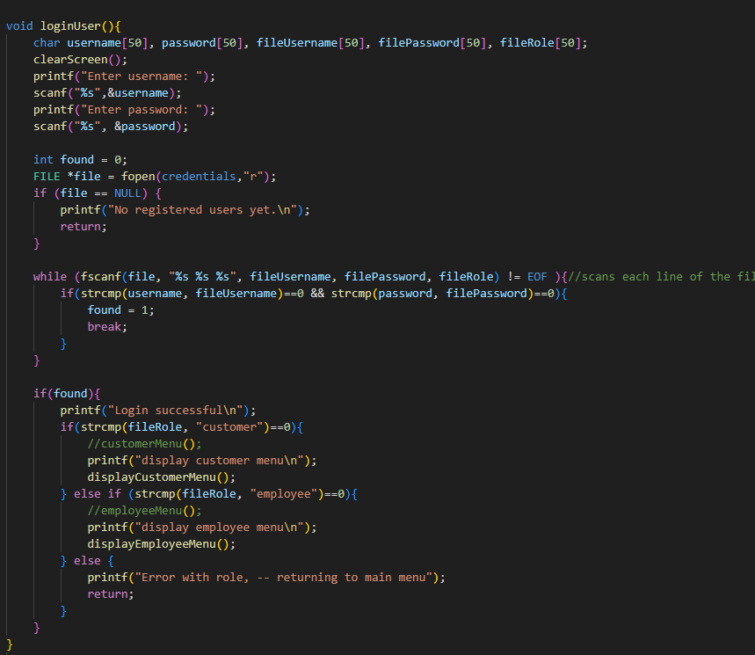
Register User
2

Slide 10


Inventory Management
Inventory

Slide 11
1

Slide 12
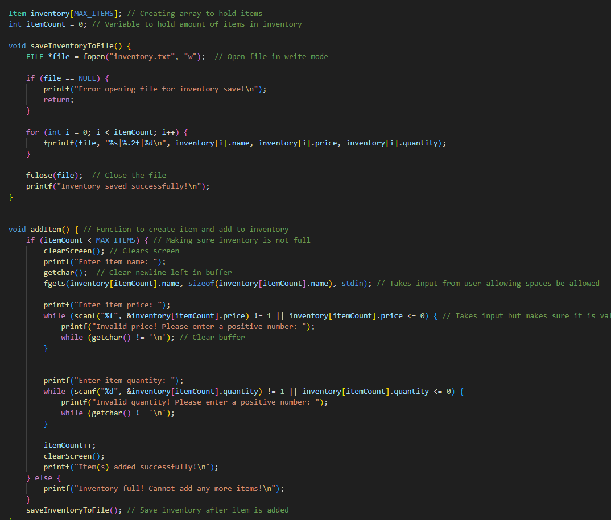
The Inventory
1

Slide 13

PayRoll
PayRoll

Slide 14
1

Slide 15
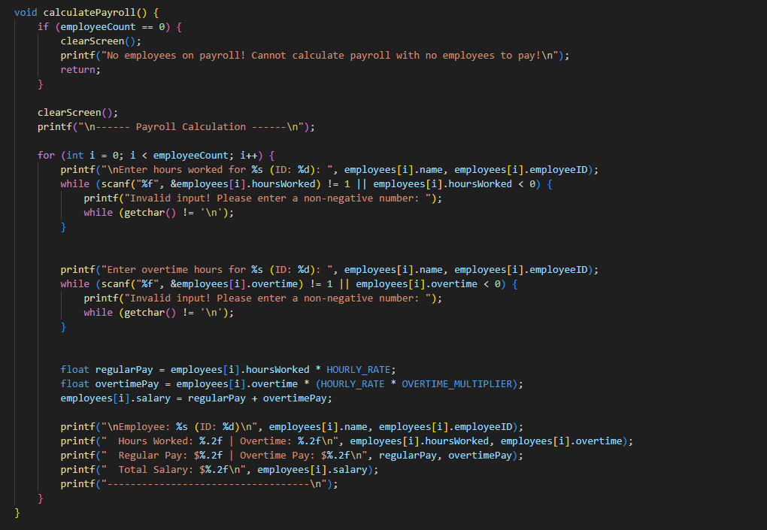
Payroll
1

Slide 16

File Handling

Slide 17
1

Slide 18
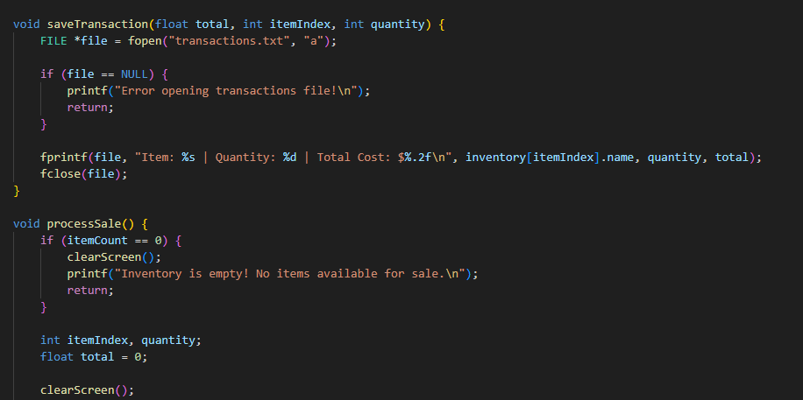
File Handling
1

Slide 19

LIVE DEMO
Live Demo!

Slide 20

Why Us?
Why us?

Slide 21
1

Slide 22
Efficiency
1
We know everything already
Nothing is secret
Nothing is Safe
Delicious Credit Credentials >:)
We are efficient
Everything Is secure
Peace of mind

Slide 23

Closing Remarks
Thank you!

Slide 24

Questions

